Slide 1
Game Galaxy A JavaFX And Java Swing Desktop App
MCA 3rd Sem Project Presentation
Date : 11 - Jan - 2024
Presented By: -> Iram Farooqui
-> Shivam Prajapati

Slide 2
Introduction and Background of the Project
Game Galaxy is a captivating 2D platform game developed in Java, aiming to offer creative gameplay and engaging visuals.
The project originated from a personal interest in exploring the graphical aspects of Java.
In the era of computers, mobiles, and gaming consoles, Game Galaxy provides a digital entertainment platform.
Features Single Player Games: Snake Game, Java Quiz Game, and Two Player Games: Tic Tac Toe, Pong Game.

Slide 3
Technology used
UI Design:
JavaFX used for user interface design.
Game Development:
Java Swing implemented for the actual game development.
Database Handling:
DBMS: MySQL
Java Database Connectivity (JDBC): Utilized JDBC for seamless interaction with the MySQL

Slide 4
OverVIEW OF PROJECT

Slide 5
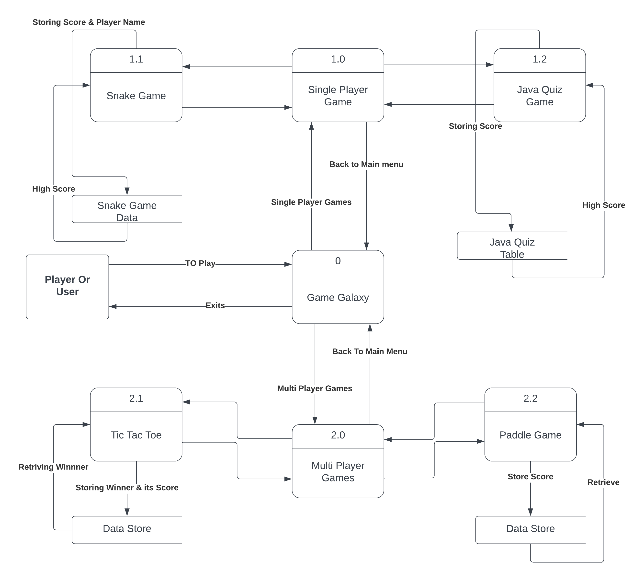

Slide 6
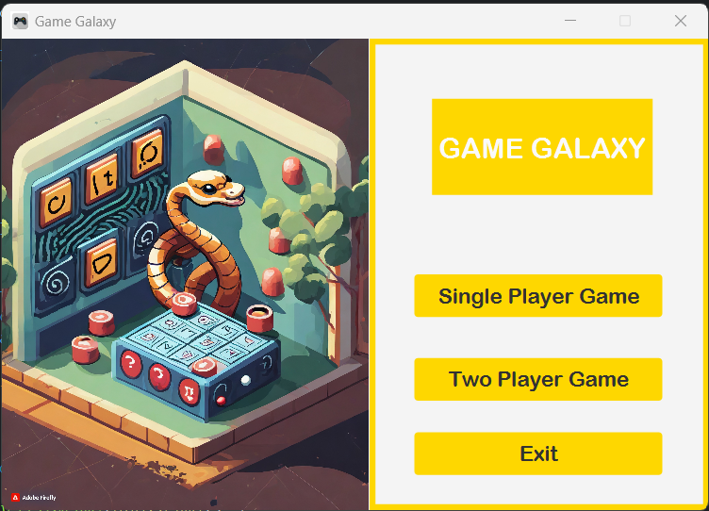
Front Page

Slide 7
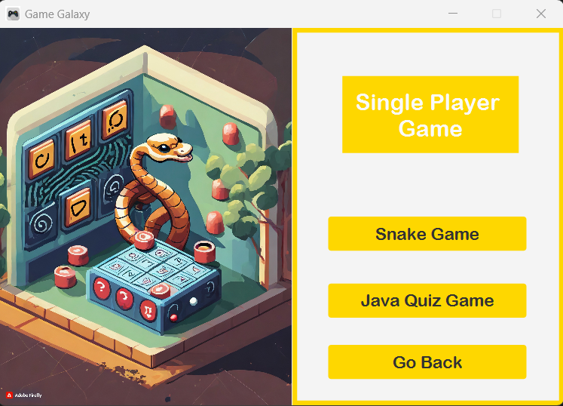
Single player page

Slide 8
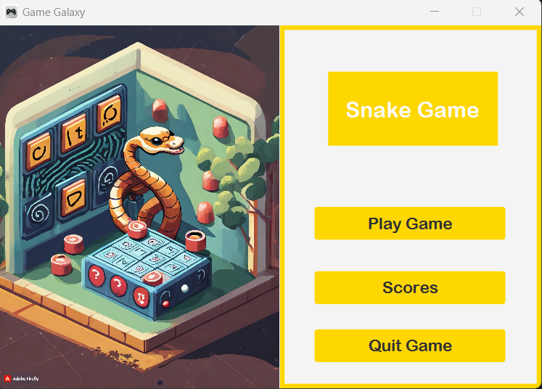
Snake game page

Slide 9
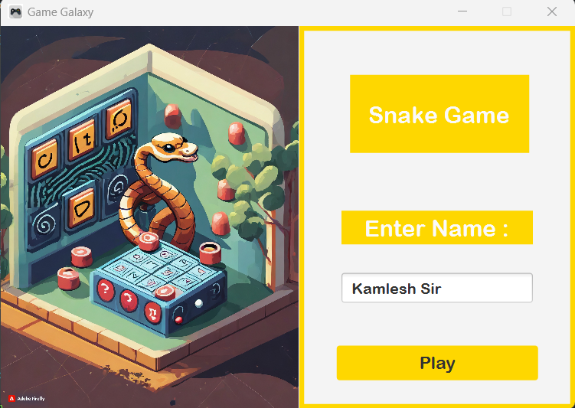

Valid Name
INValid Name

Slide 10
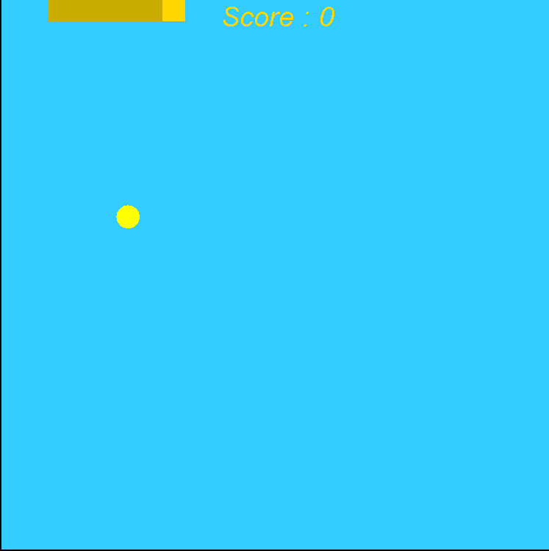
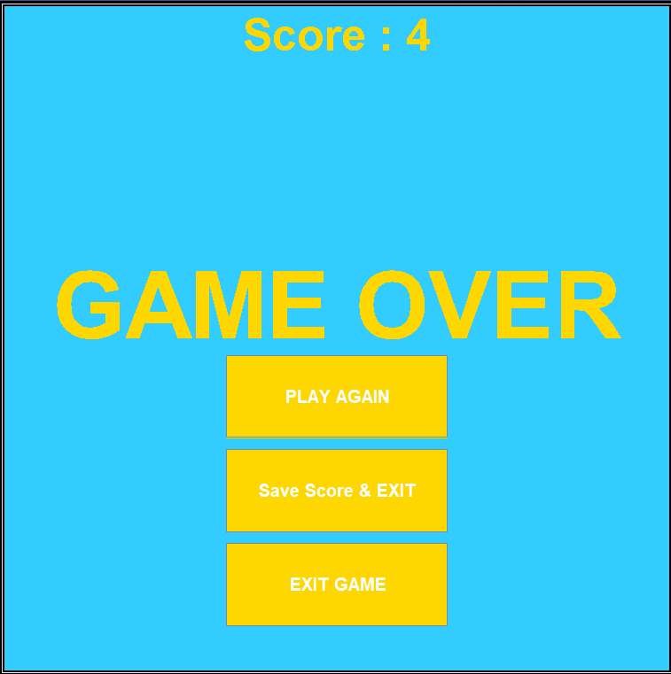

Slide 11
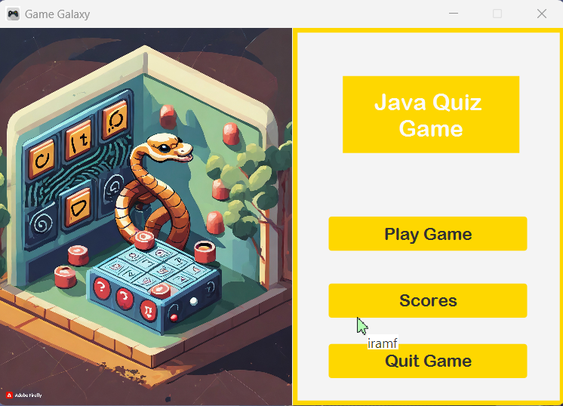
Java Quiz game page

Slide 12

Enter name

Slide 13
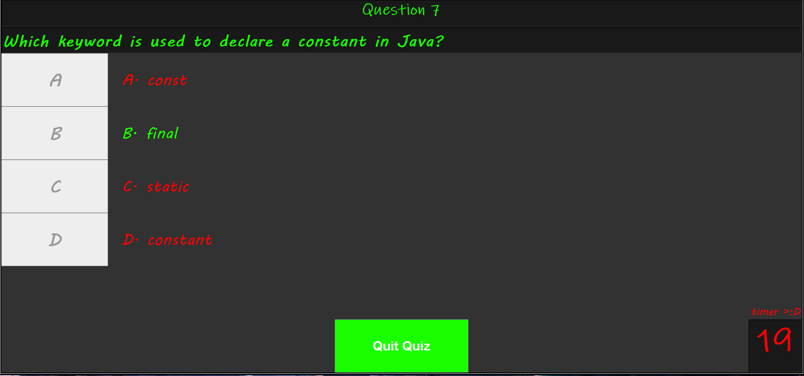

Slide 14
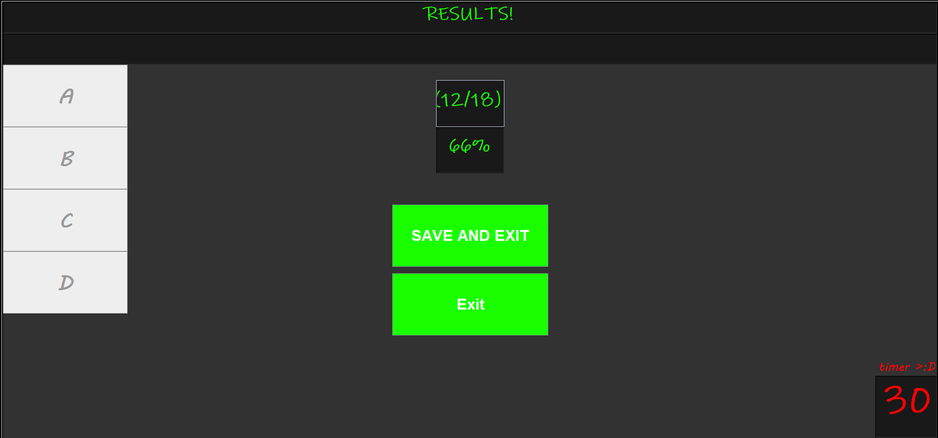

Slide 15
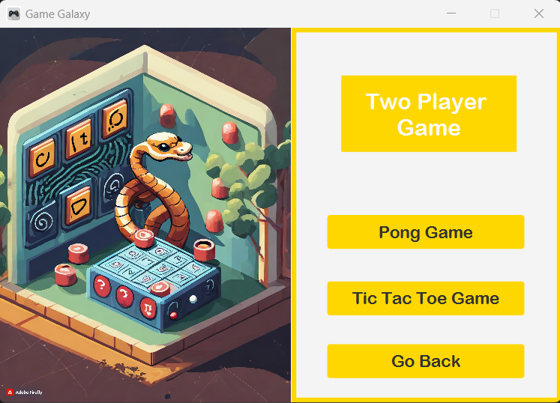
Two player game

Slide 16
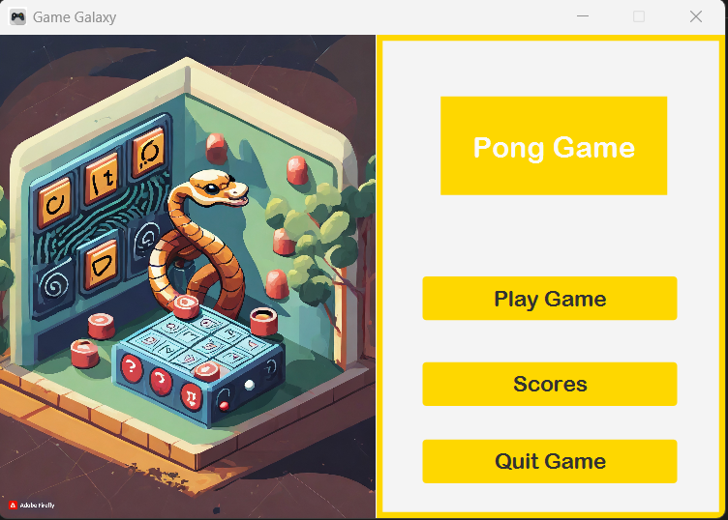
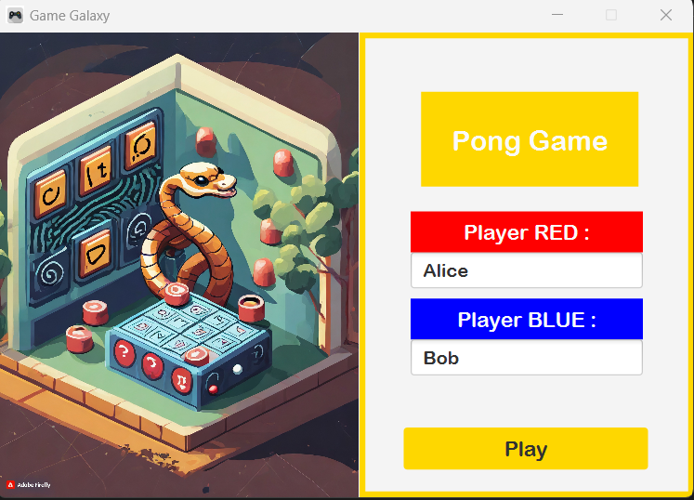
Pong Game page

Slide 17
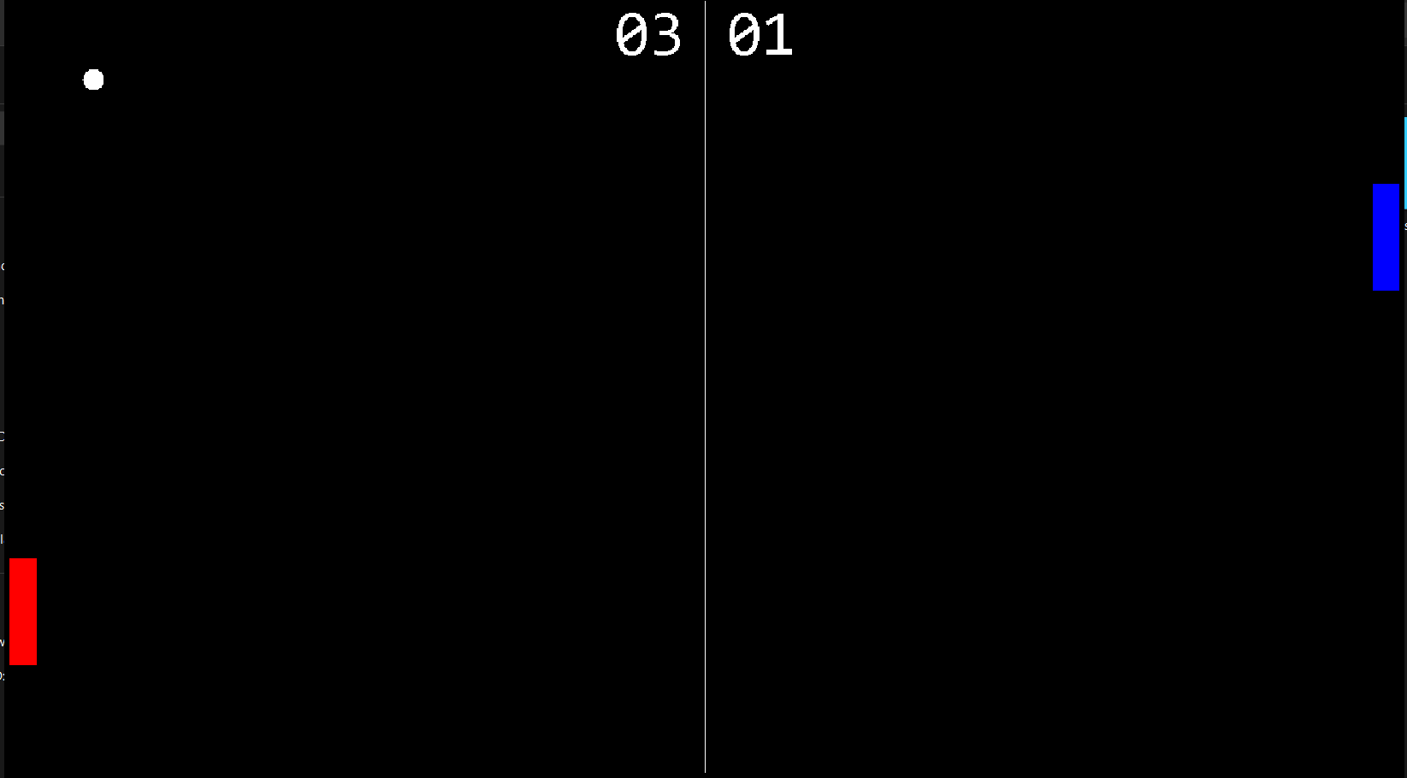

Slide 18
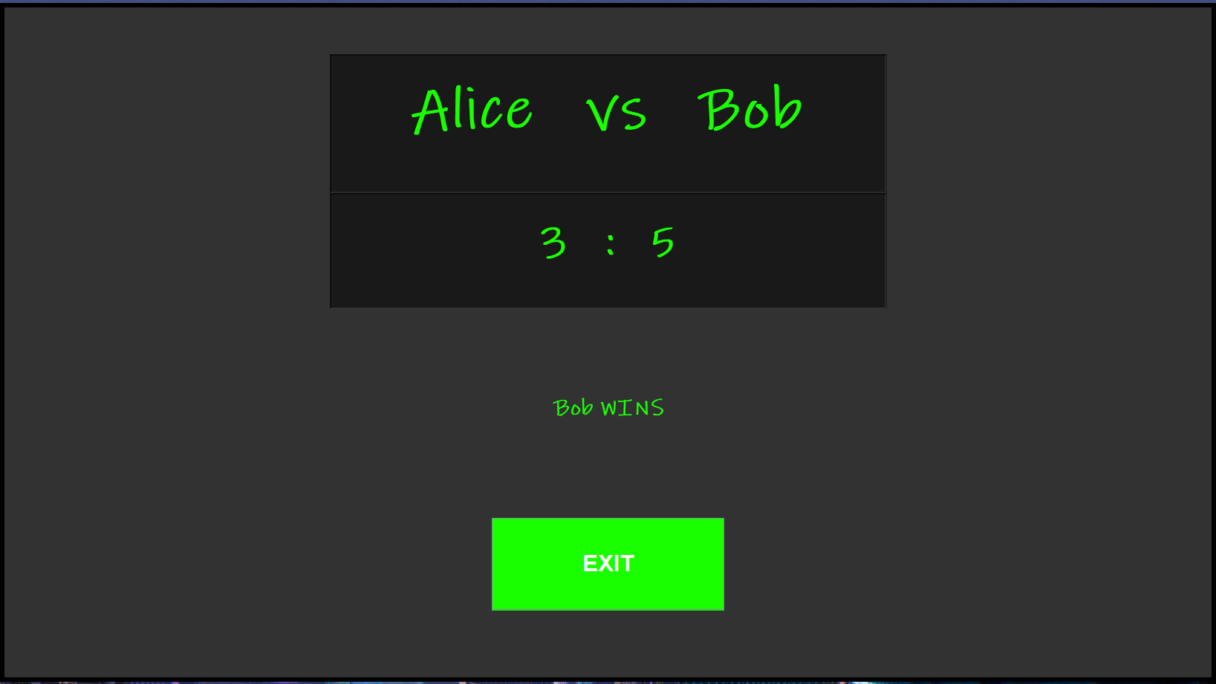

Slide 19
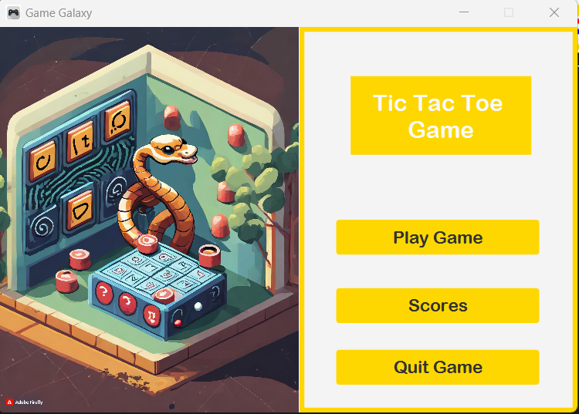
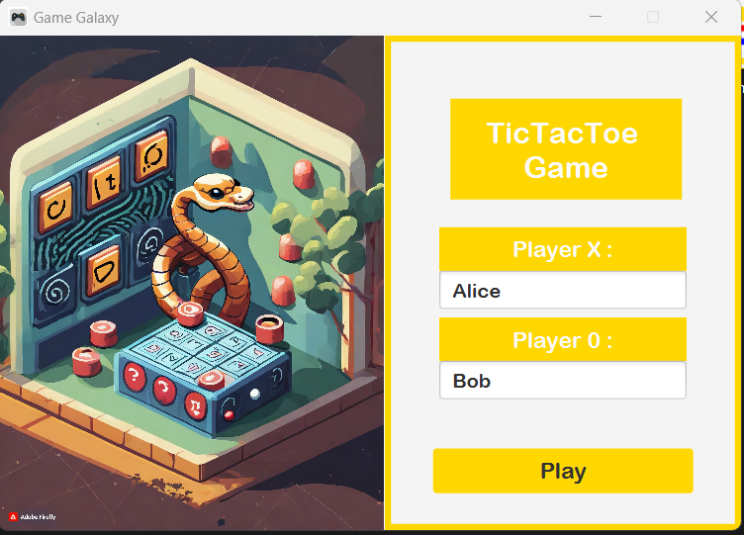
Tic Tac Toe Page

Slide 20
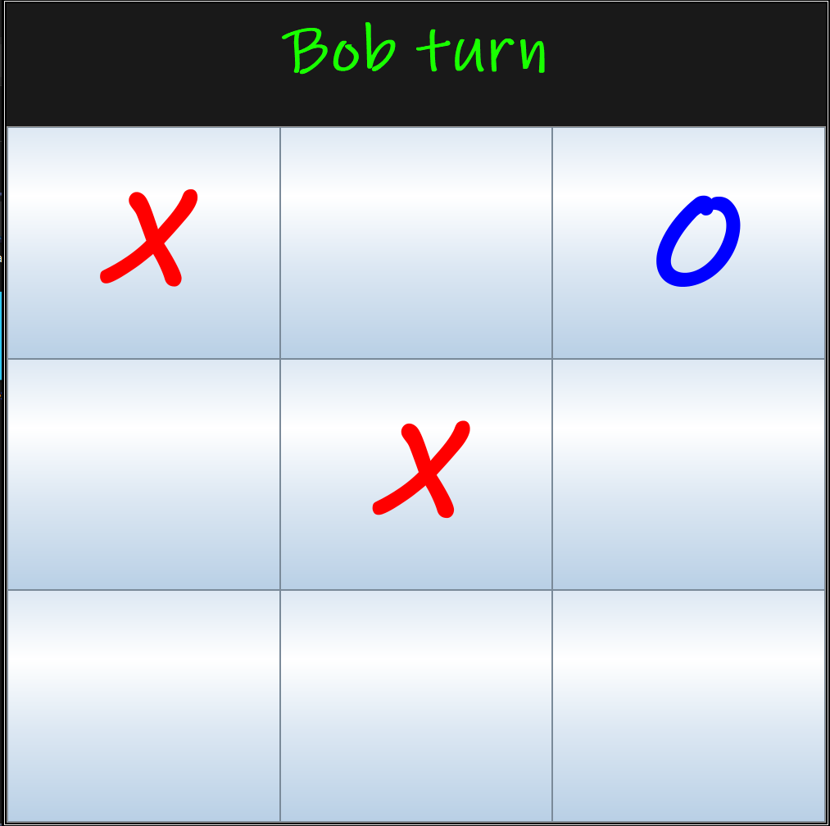
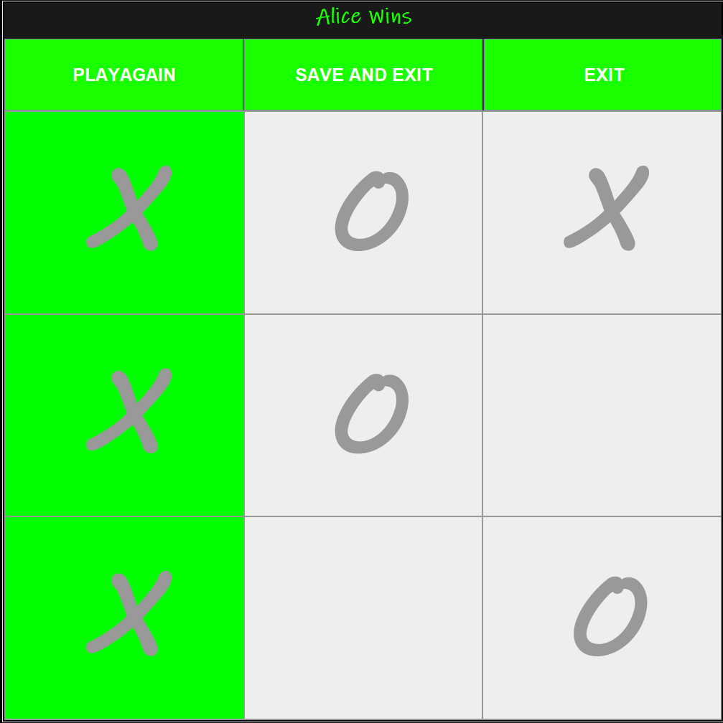

Slide 21
Objectives :
If you want to relax
If you want to check your knowledge
Entertainment
Stress Relaxation
To Prevent boredom
Challenges & Achievements

Slide 22
Thank you

